Slide 1
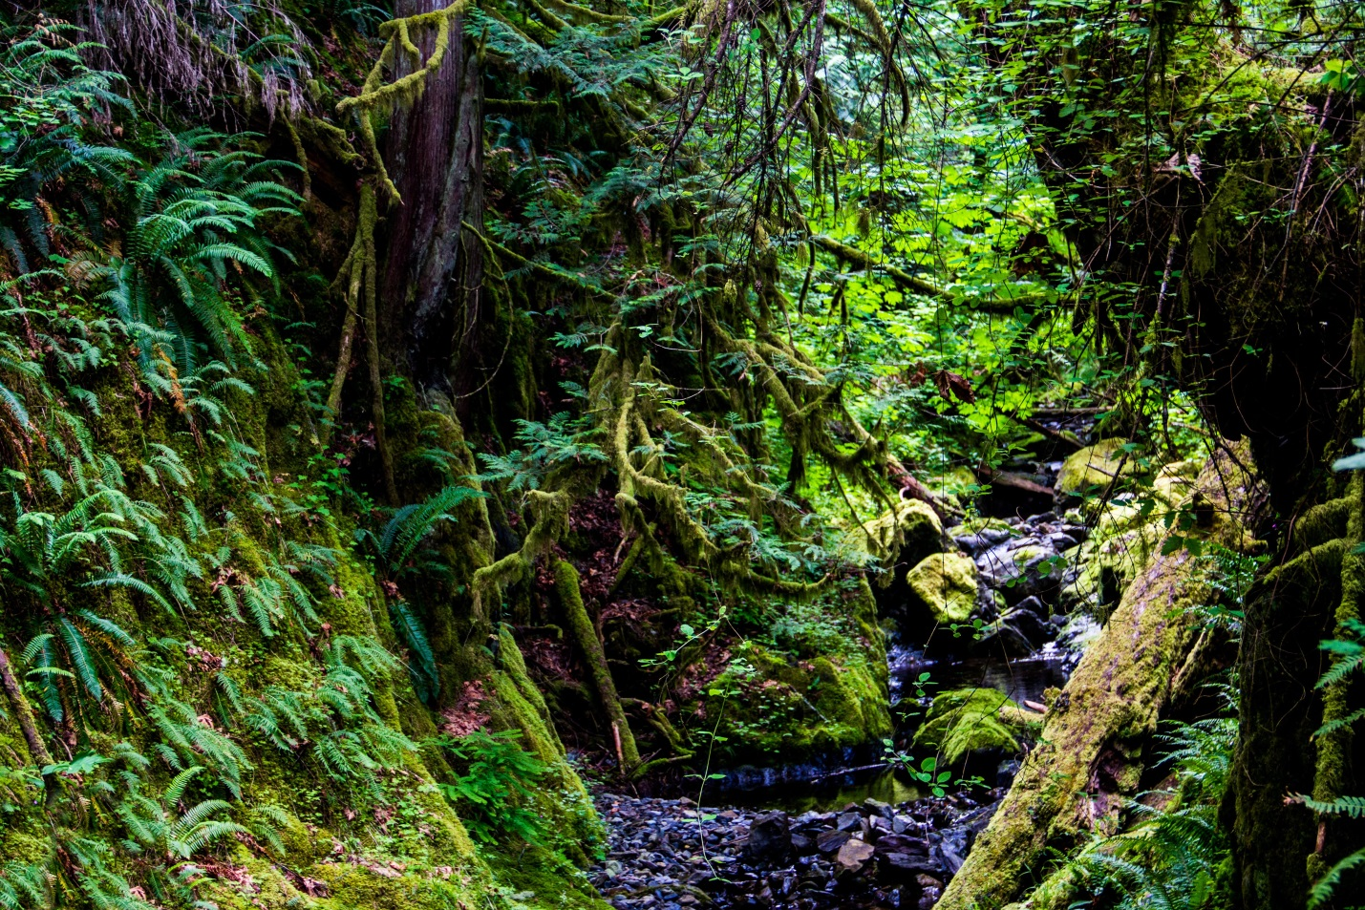
Crown expectations for small stream outcomes under FRPA

Slide 2
Objectives set by government for water, fish, wildlife and biodiversity within riparian areas.
FPPR Section 8 The objective set by government for water, fish, wildlife and biodiversity within riparian areas is, without unduly reducing the supply of timber from British Columbia's forests, to conserve, at the landscape level, the water quality, fish habitat, wildlife habitat and biodiversity associated with those riparian areas.

Slide 3
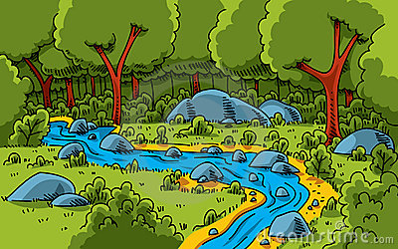

Does the Crown provide any other guidance around expected outcomes for streams?

Slide 4

It does!
The Factors !

Slide 5
Factors relating to objective set by government for water, fish, wildlife, and biodiversity in riparian areas. FPPR Schedule 1, Section 2
2 The following factors apply to a result or strategy for the objective set out in section 8 [objectives set by government for water, fish, wildlife and biodiversity within riparian areas]:
(a) the type of management regime that is required for a riparian area, having regard to
  (i) the need to buffer the aquatic ecosystem of a stream, wetland or lake from the introduction of materials that are deleterious to water quality or fish habitat,
  (ii) the role played by trees and understory vegetation in conserving water quality, fish habitat, wildlife habitat and biodiversity,
  (iii) the need to maintain stream bank and stream channel integrity, and
  (iv) the relative importance and sensitivity of different riparian classes of streams, wetlands and lakes in conserving water quality, fish habitat, wildlife habitat and biodiversity;

Slide 6
Factors relating to objective set by government for water, fish, wildlife, and biodiversity in riparian areas. FPPR Schedule 1, Section 2
(b) the type, timing or intensity of forest practices that can be carried out within the context of a management regime referred to in paragraph (a);
(c) the role of forest shading in controlling an increase in temperature within a temperature sensitive stream, if the increase might have a deleterious effect on fish or fish habitat.

Slide 7
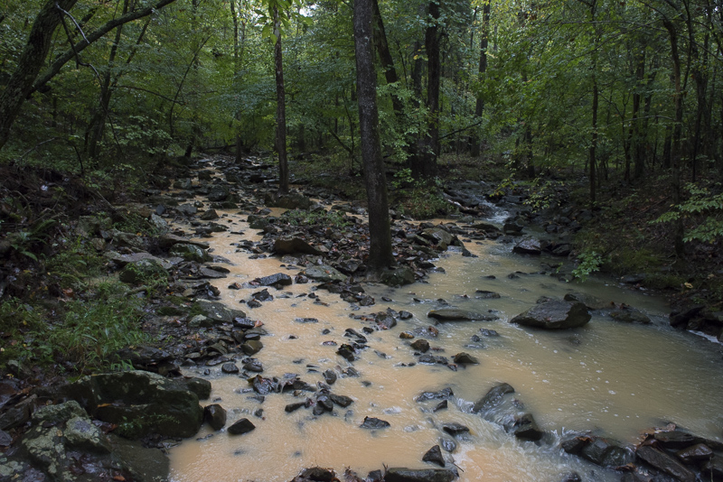
A factor: Sedimentation that could impact water quality and fish habitat

Slide 8
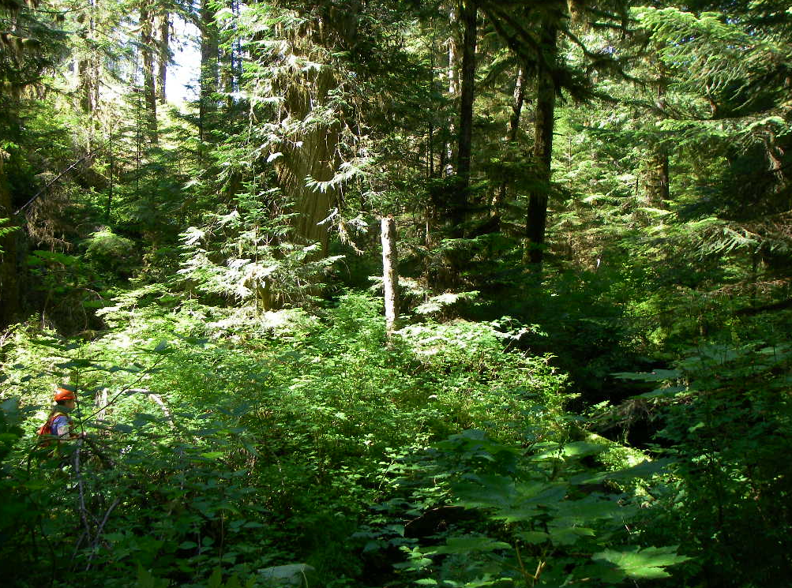
A factor: The role that trees and vegetation play in conserving water quality, fish & wildlife habitat and biodiversity

Slide 9
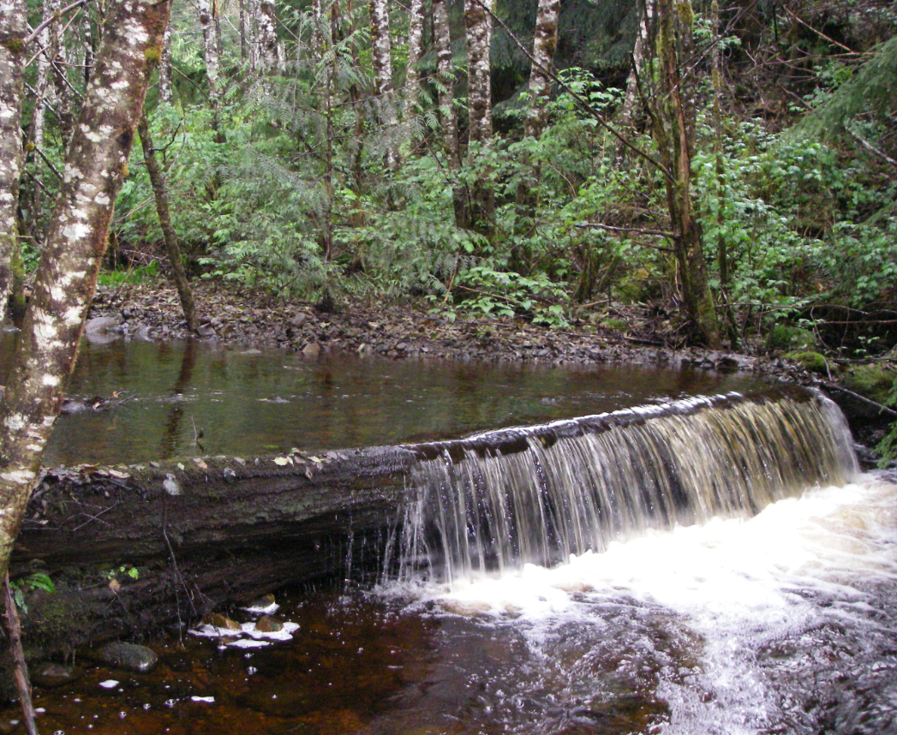
A factor: The need to maintain stream banks and channels

Slide 10
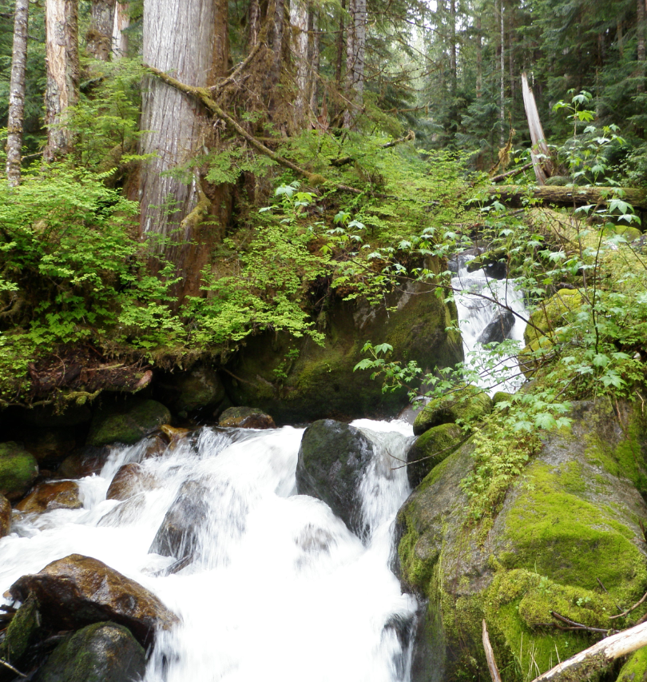
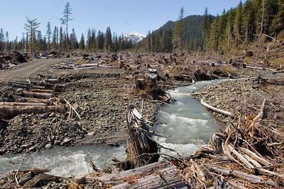
A factor: Relative importance of different riparian classes of streams

Slide 11
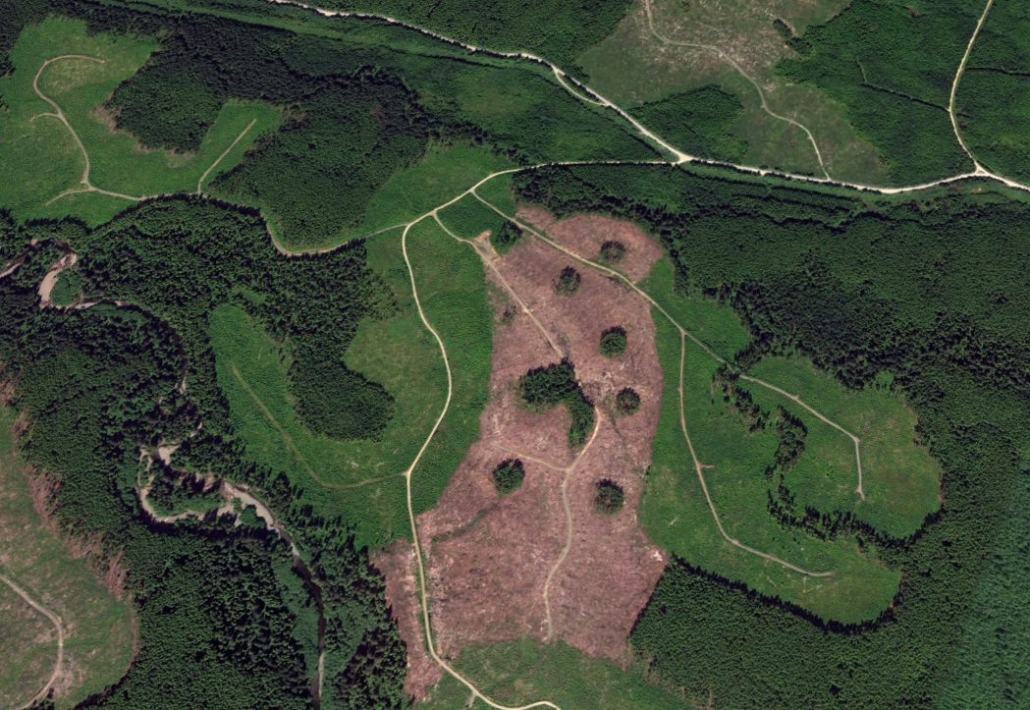
A factor: The type, timing and intensity of forest practices

Slide 12
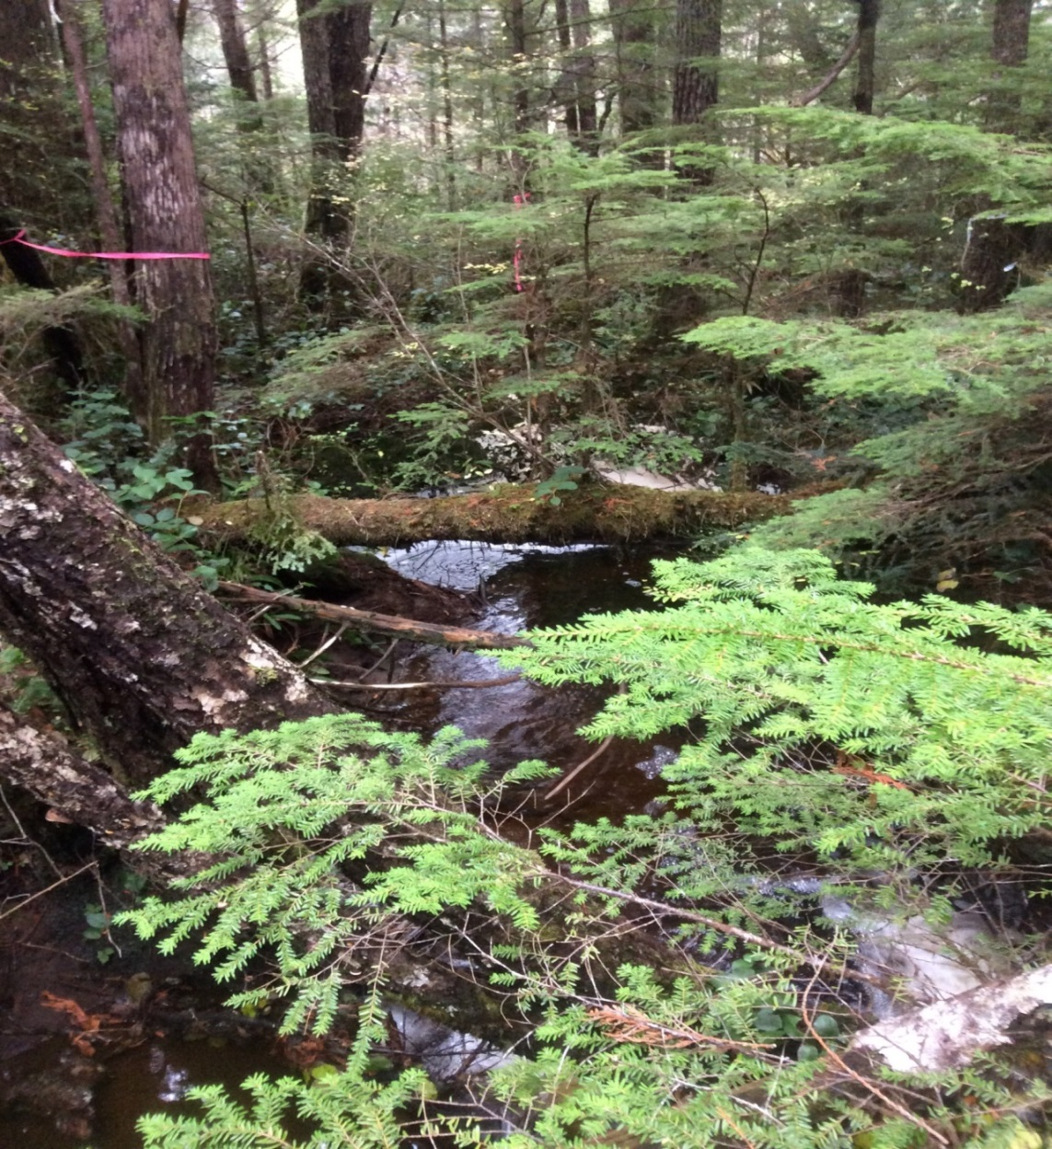
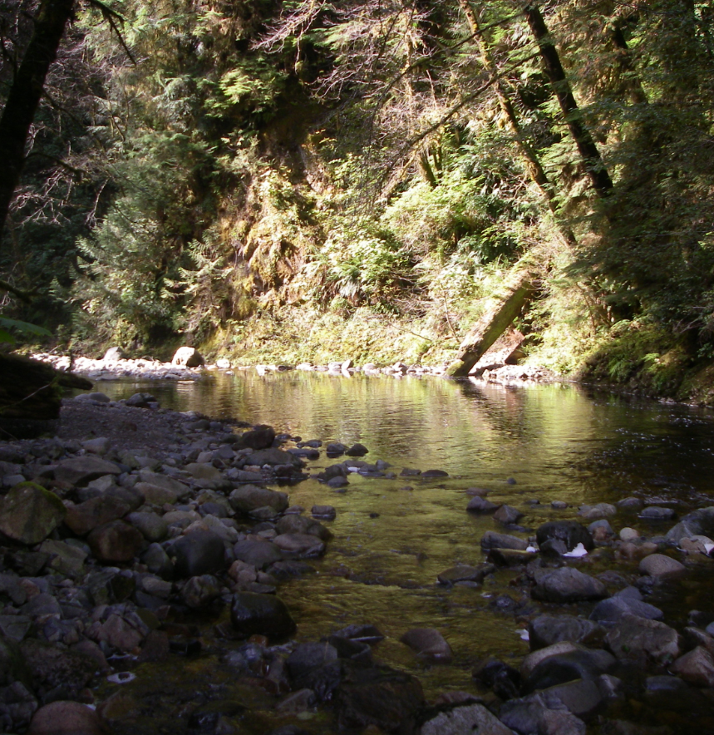
A factor: The role that forest shading plays in controlling temperature within a temperature sensitive stream

Slide 13
The factors are awesome, but is there any other guidance……..?

Slide 14
Yes, there is more!
FPPR section 52(2)!

Slide 15
FPPR section 52 (2)
2) An authorized person who cuts, modifies or removes trees in a riparian management zone for an S4, S5 or S6 stream that has trees that contribute significantly to the maintenance of stream bank or channel stability must retain enough trees adjacent to the stream to maintain the stream bank or channel stability, if the stream
(a) is a direct tributary to an S1, S2 or S3 stream,
(b) flows directly into the ocean, at a point near to or where one or more of the following is located:
(i) a herring spawning area;
(ii) a shellfish bed;
(iii) a saltwater marsh area;
(iv) an aquaculture site;
(v) a juvenile salmonid rearing area or an adult salmon holding area, or
(c) flows directly into the ocean at a point near to the location of an area referred to in paragraph (b) and failure to maintain stream bank or channel stability will have a material adverse impact on that area.

Slide 16
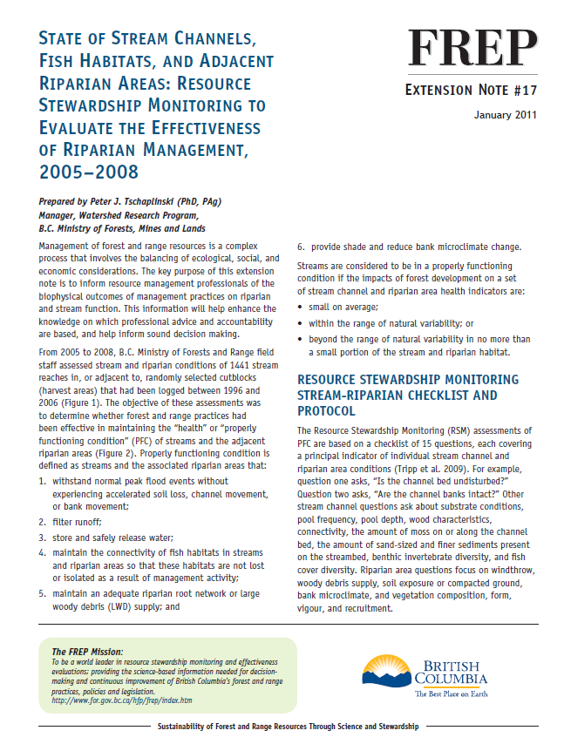
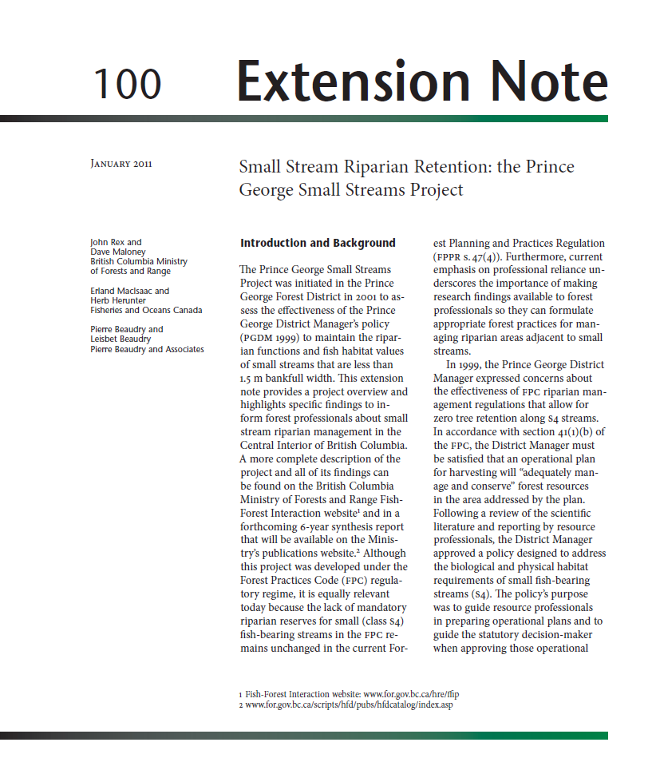
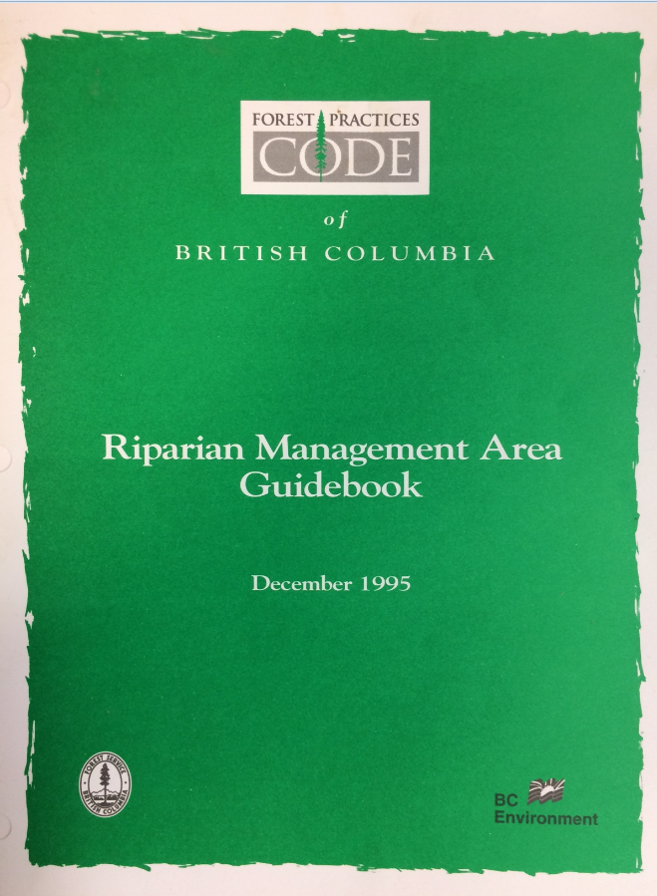
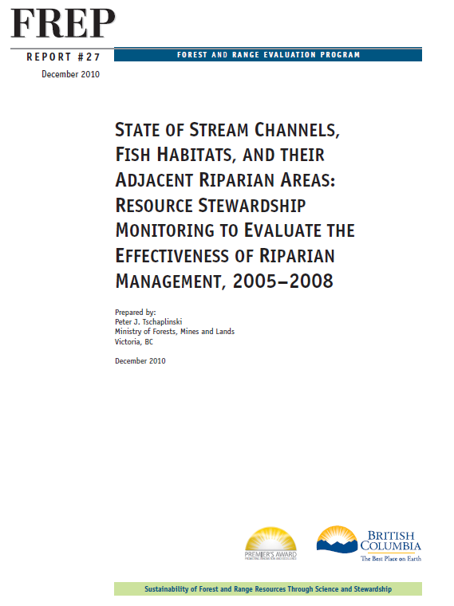
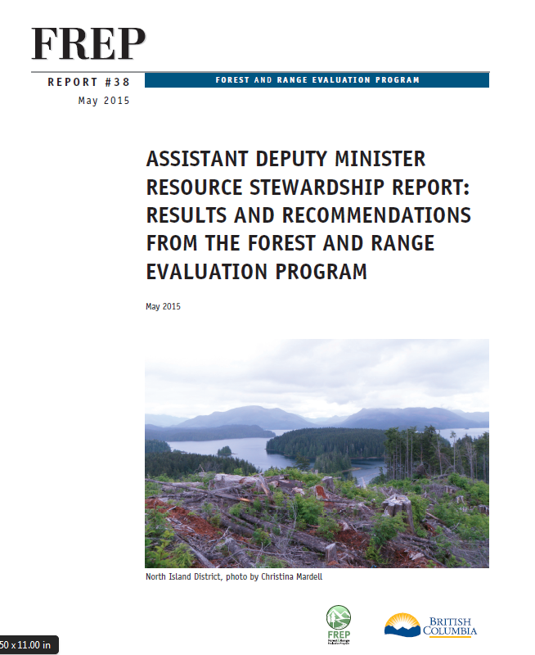
There are lots of other guidance documents too!

Slide 17
FSP approval test
Your result or strategy must:
  1) be consistent with the objective
  2) be measurable or verifiable

Slide 18
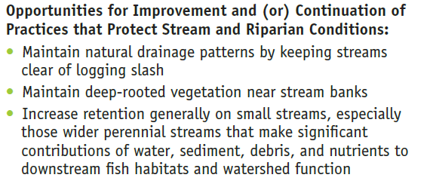
ADM Stewardship Recommendations, FREP Report 38

Slide 19
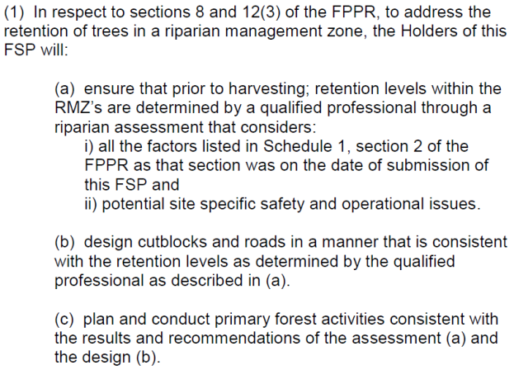
Example of a strategy to manage small streams

Slide 20
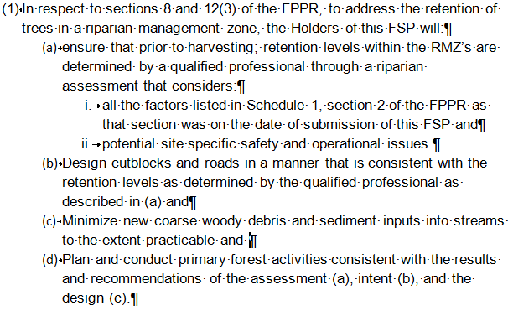
Example of a complete strategy to manage small streams

